Slide 1
TRADITIONAL MEDIA
Making the best out of traditional media
Bhimanto Suwastoyo
The Scribe
Bhimanto@thescribe.id

Slide 2
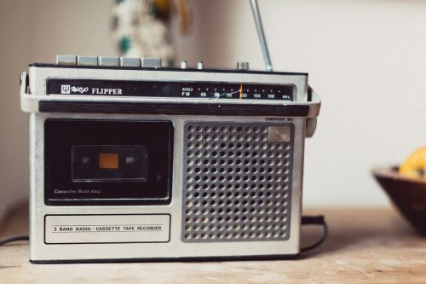
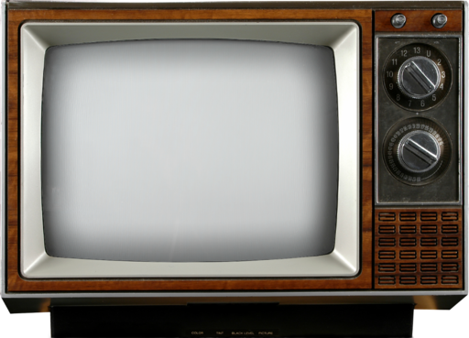
WHAT IS THIS BEAST?
2
Any form of mass communication available before the advent of digital media
Includes television, radio, newspapers, newsletters, magazines, leaflets ect.

Slide 3
W HAT ARE THE CHARACTERISTICS?
3
Offers a wider audience pool
High accessibility
Highest level of selectivity of all media.
High quality control.
High personalization.
Creative flexibility.
Long life span for some

Slide 4
NEWSPAPERS
4
Pros:
Newspaper rank highest for believability for all media, especially with an older audience.
High local coverage and daily delivery of your message.
Excellentmedium
An interactive medium [people hold it, save it, write on it, cut coupons, etc.].
Cons:
- Very busy/cluttered competitive environment [must compete against other newsreports]
- Little control over placement.
- Low production quality.
- Hard to target a specific audience.

Slide 5
Magazines
5
Pros :
Visually attractive .
Long shelf life with high pass-along readership.
High readership rates and reader loyalty.
High ability to select audience.
Sometimes linked to prestig
Cons:
- Long lead times. Unable to deliver your message immediately.
- Heavy clutter – content has to vie against others.
- Can’t deliver your message with a high frequency.

Slide 6
TELEVISION
6
Pros:
Immediate delivery of message
High frequency of message [you can repeat several times per day].
Very high impact – TV is the best for stimulating the senses.
High mass audience coverage, high prestige.
Audience selectivity in case of cable television
Low cost per thousand [CPM] exposures.
Cons:
Very high costs of production and airtime.
Limited audience selectivity.
Short message lifetime [no shelf life].
High advertising clutter.
High possibility of channel switching.

Slide 7
RADIO
7
Pros:
Immediate delivery of message.
high frequency of message [you can repeat several times per day].
Local audience. Selectivity by format. High availability.
Low cost production.
Reach an exclusive and captive [mobile] audience.
Cons
Limited to audio message.
High channel switching.
Your message expires immediately [no shelf life].
High advertising clutter.

Slide 8
NEWSLETTERS
8
Pros:
Highest level of selectivity of all media.
High quality control.
A measurable media for cost and response. Easy to test.
High personalization.
Creative flexibility.
Long life span.
Cons:
Highest cost per exposure.
Negative connotations about owned media

Slide 9
TRADITIONAL MEDIA IN THE EVOLVING MEDIA LANDSCAPE
9
Traditional media might be the older form of mass communication, but traditional communication methods are not going anywhere soon. There are still a substantial amount of money spent on traditional advertising, especially television.
Traditional media is a one way conversation rather than engagement.
Traditional media is pre-made and scheduled, not real time.
Traditional is a mass communication system as opposed to one-on-one one.

Slide 10
WHICH MEDIA TO USE?
10
Picking the right media
Determine the target audience
Choice affect how the message is packaged
The general trick [look at wire service]

Slide 11
WHAT IS ATTRACTIVE TO TRADITIONAL MEDIA?
11
Compact, simple and relatable.
story line
supporting quotes
supporting data

Slide 12
TYPES OF LEAD PARAGRAPH
12
1. The summary lead
Most often found in straight news reports, It clearly sums up the situation, giving the reader the most important facts first.
"Indonesia must anticipate that the negative campaign which has so far targeted palm oil, one of its of top export earners, may later also spread to its other equally important commodities, a senior official said here Friday (18/9)."
“Member states of the Association of Southeast Asian Nations (ASEAN) need to increase itheir inter-regional trade if they want to sustain growth amid declining demand for Southeast Asian exports in the West and Japan, a World Bank economist said in Jakarta on Tuesday.

Slide 13
TYPES OF LEAD PARAGRAPH
13
2. A creative or descriptive lead
This can be a scene description, or a funny a quirky fact, among other things. Better suited to feature stories and blog posts, these leads are designed to pique readers’ curiosity and draw them into the story.
"Hundreds of traumatised patients are crammed into every available space at the Panti Rapih Catholic hospital, and the parking lot has become a giant open-air waiting room.
Widiarti, 26, waited alone on a narrow stretcher laid in front of the radiology room, her badly bruised face and arms peeking out from under the dirty cloth used to cover her. Sastroutomo, an elderly woman, lay on a mat on the floor. She could not speak as her face was swollen and her mouth black with dried blood. A card next to her head read, "Radiology needed".
One nurse said staff at the hospital in the central Indonesian city of Yogyakarta were struggling even to register the hundreds of patients in need of help after Saturday's earthquake which killed over 3,300 people.”
" Sixty-year-old La Baire can still clearly remembers the first time he began to fish for sharks in the waters near the Indonesian Australian sea border in 1982. It was during the golden days of shark hunting.
Now, not even two decades later, he would be lucky if his catch could cover the cost of his fishing sorties.”

Slide 14
THE IMPORTANCE OF THE LEAD PARA
14
It acts as the bait
Prevailing short attention span
Provides a general glimpse of the content
May be the only content read

Slide 15
FASHIONING AN ATTRACTIVE LEAD PARA
15
The principles - compact, simple, relatable
Simplicity (choice of words)
Compactness (length)
Relatability (human face)
Picking the angle (softsell vs hardsell)
Accuracy

Slide 16
THE DON’Ts
16
Don’t make your readers work too hard.
Don’t try to include too much.
Don’t be cliche.
Don’t have any errors.
Don’t state the obvious.

Slide 17
THE MEAT
17
Quotes
Story line
Supporting data
Conclusion/summary

Slide 18
BEYOND THE CONTENT
18
Communication is about interaction, relationship
Boost the chances of your press releases being used.

Slide 19
THAT’S IT FOLKS!

