Slide 1
How to Engage with Media: Strategy and Tips & Tricks
TV
NEWS
RADIO
WEBSITE
Presented by:
Fransisca Fitri
Executive Director of
YAPPIKA-ActionAid
2nd Communication Workshop for
EU-Funded Projects
November 4, 2020
FB
T
You
Tube
@

Slide 2
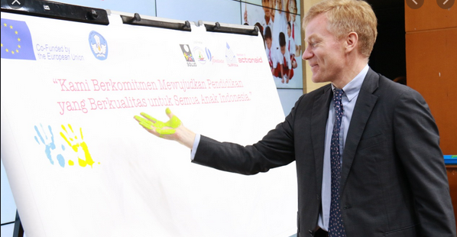
Pro-InQluEd: Promoting civil society-led initiatives for inclusive and quality education in Indonesia
TARGETS Op4 | ACHIEVEMENTS
18 articles by local mainstream media journalists | 142 articles
3 talk shows | 2 talk shows in KOMPAS TV, 10 talk shows in Mustang radio, 3 talks shows in CSM TV Sambas
70,000 responses (clicks, likes, comments, shares) | 23,302 people reached by social media campaign, 40,248 responses (clicks, likes, comments, shares)
60 citizen journalists will produce an article every quarter in social media from Year 2 | 63 citizen journalist, 11 articles published in local media
Feb 2018 - Project started in 3 locations: Sambas, Bima and West Sumba with 3 co-partners: Gemawan, Solud and Bahtera.

Slide 3
First think first
Develop a communication plans
Identify media to communicate the programme
Set the communication targets
Select communication activities/materials

Slide 4
Media selected for publicizing the programme
Local newspaper - print/online
Television – national/local
Radio – Jakarta/national streaming
Social media – Website, FaceBook, Twitter, Instagram

Slide 5
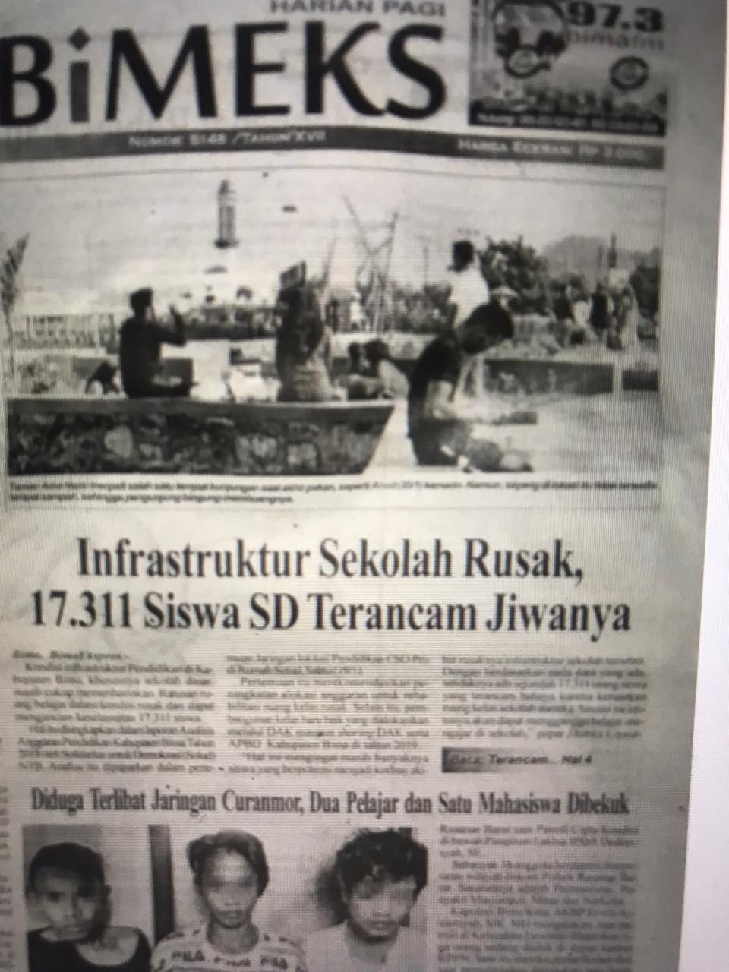
Programme’s communication strategy
Meet with journalists/editors and/or set a journalists gathering
3
Invite media journalists to visit schools to create stories (not only a single article)
Maintain personal relation with journalists
2
4
1
Write and distribute press release
Conduct citizen journalism training
5

Slide 6
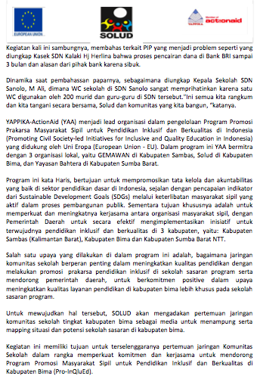
Press release
Direct quotes
Name of donor
Project title
Our organization’s name
Co-partner’s name
Project objectives
Next activity
Direct quotes

Slide 7
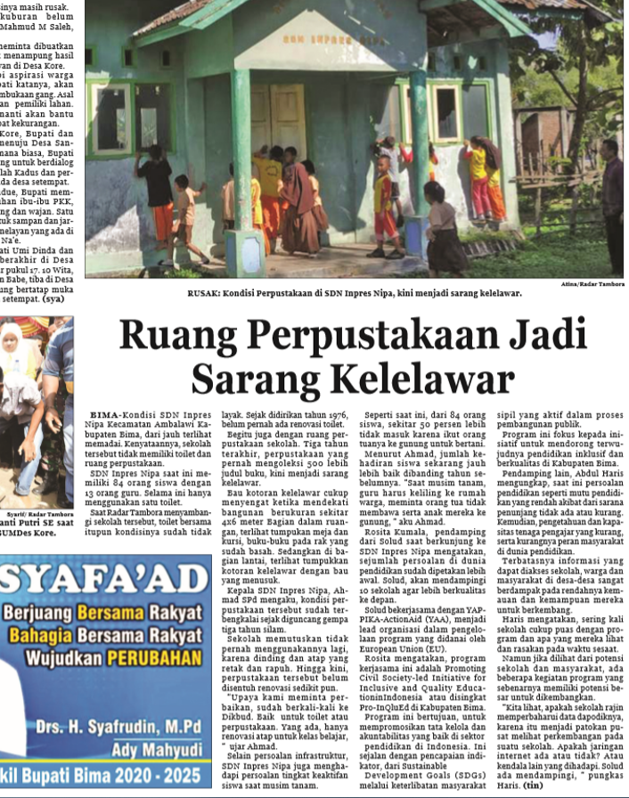
Media journalists visit to schools
Tips & Tricks: In a visit, a journalist writes at least two articles. We invited 5-8 different media journalists in one visit. Journalist will/not do a follow up interview to the local government about the schools.
Challenges: make sure the journalist agree to write about the issue; agreed upon a mutual collaboration (no financial reward, only content for articles); get continuous attention to the issue.

Slide 8
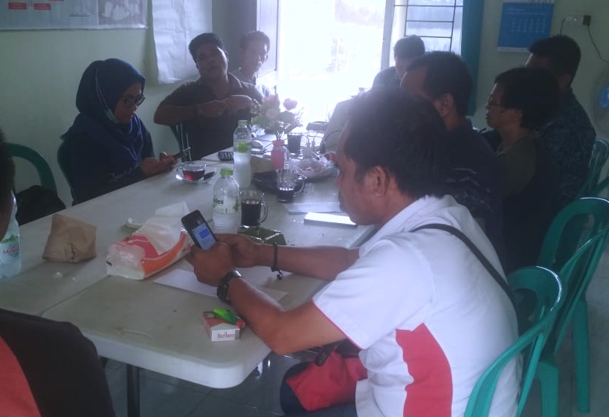
Media journalists gathering
Tips & Tricks: We need to set up a mutual partnership with media/journalist – programme provides content, no financial rewards; work with many journalists, including contributors.
Challenges: journalists were not interested in writing news/articles about education issues until they visit the schools.

Slide 9
63 citizen journalists (of 60 person in the target) from school community members have trained on basic journalism.
Challenges: Knowledge and skills on writing article is still very basic, need to provide continuous support to enable them apply their new knowledge and skills, journalism activities are the secondary for most of the citizen journalists which affects the frequency of their articles.
CITIZEN JOURNALISM TRAINING

Slide 10
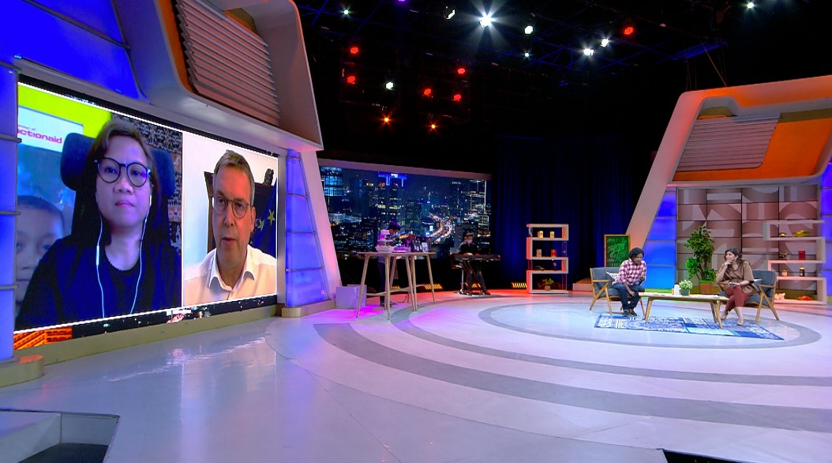
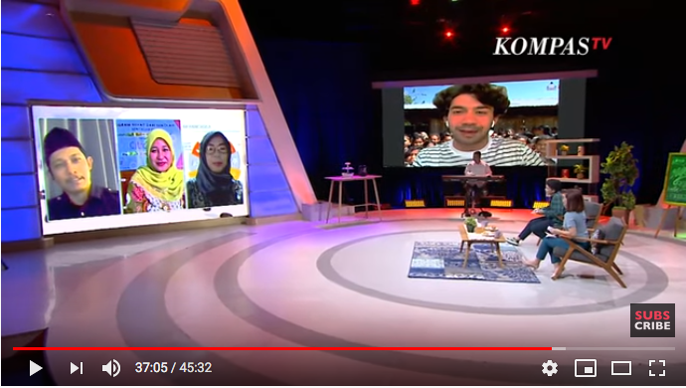
Awareness campaign with television and radio
National:
KOMPAS TV – 2 sessions in NGOPI programme (8 pm).
Mustang radio – 10 sessions in Talkshow Sore programme (6.30 pm).
Local:
CSM TV Sambas – 3 sessions

Slide 11
Social media campaign
Social media
Website, FaceBook, Twitter, Instagram – YAPPIKA
Website, FaceBook – three co-partners
FaceBook, Twitter, Instagram – YAPPIKA and co-partners’ staff and school community members
Method: organic and boosting

Slide 12
Thank You!

