Slide 1
2nd Visibility Workshop for EU-funded Projects Traditional Media and Webinar Tips
Session 4 – Webinar Tips
Israr Ardiansyah

Slide 2
Webinar Facts (1)
Webinars are increasingly important in the programme sustainability, and their popularity is on the rise, especially during the coronavirus pandemic.
Webcasts have seen a 47% increase in average viewing time this year, which makes this an important form of communication.
There is so much information out there that is vital to programmes and by hosting a webinar you can show your programmes, achievements, and upcoming activities to people looking to learn, as well as to your beneficiaries and stakeholders.
In order to be successful at reaching audiences during a webinar, we need to understand the current trends.

Slide 3
Webinar Facts (2)
The ON24 Webinar Benchmarks report looks at the how’s, what’s, and why’s of the current state of webcasting, and here are the trends that they reported:
The best days to hold a webinar: Tuesday, Wednesday, Thursday
Most webinar registration is the week of the webinar date which is 58%
There was an average of 28% registration on the day of a webinar
Webinars top interactive tool is the Q&A during and after the webinar
Source: https://serendipitconsulting.com/weekly-wrap-up-the-rising-popularity-in-webinars

Slide 4
Webinar
Type of webinar
One way interaction: Youtube, IG live, FB live, Zoom Webinar, etc.
Two way interaction: Zoom Meeting, Google Meeting, Teams Meeting, etc.
Webinar platforms

Slide 5
What does each Webinar Platform offer? (1)
People can signup once for an ongoing series of webinars.
Participants have the option to send private messages to event coordinators or public messaging visible to everyone.
Registration page which is intended to keep things consistent with organization brand.
Automate replays of webinars to build email lists.
Insights into our webinar performance (insight).

Slide 6
What does each Webinar Platform offer? (2)
Insert Ad tracking pixel (e.g. Facebook ad)
Fully-automated replays on a schedule, or combine live and pre-recorded elements.
Ability to integrate with over 1,000+ apps via special plaform
Have one or multiple presenters
Run free webinars or paid virtual summits

Slide 7
What does each Webinar Platform offer? (3)
The platform tells users there’s a webinar just about to start, encouraging them to sign up on the spot.
Speak to live attendees in real time
Automatically sets your webinar plays to different time zones so you only have to schedule things once (auto detection).
Training and in-depth resources on creating webinars

Slide 8
What does each Webinar Platform offer? (4)
Custom landing page to encourage people to sign up for your webinars.
Scheduled notification to remind people about your webinar event.
Full interactivity and engagement (e.g. we can use live chat, polls and send files to audience members during the webinar)
Up to 100 interactive video participants for webinars with large panels of speakers.
Broadcast webinars to Facebook Live and YouTube.
Mute/unmute speakers for full control over participants (complete control).
Etc
(Each platform has its own uniqueness)

Slide 9
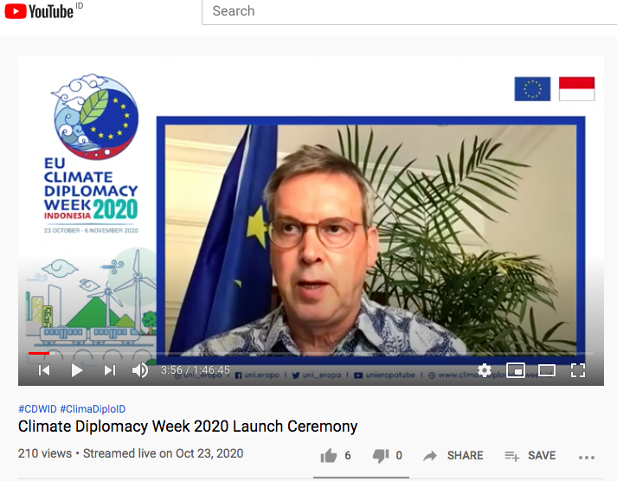
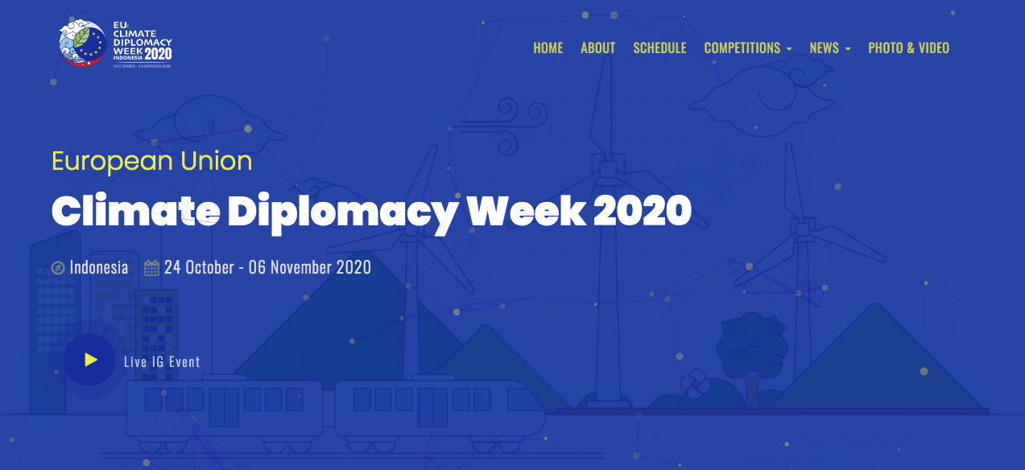
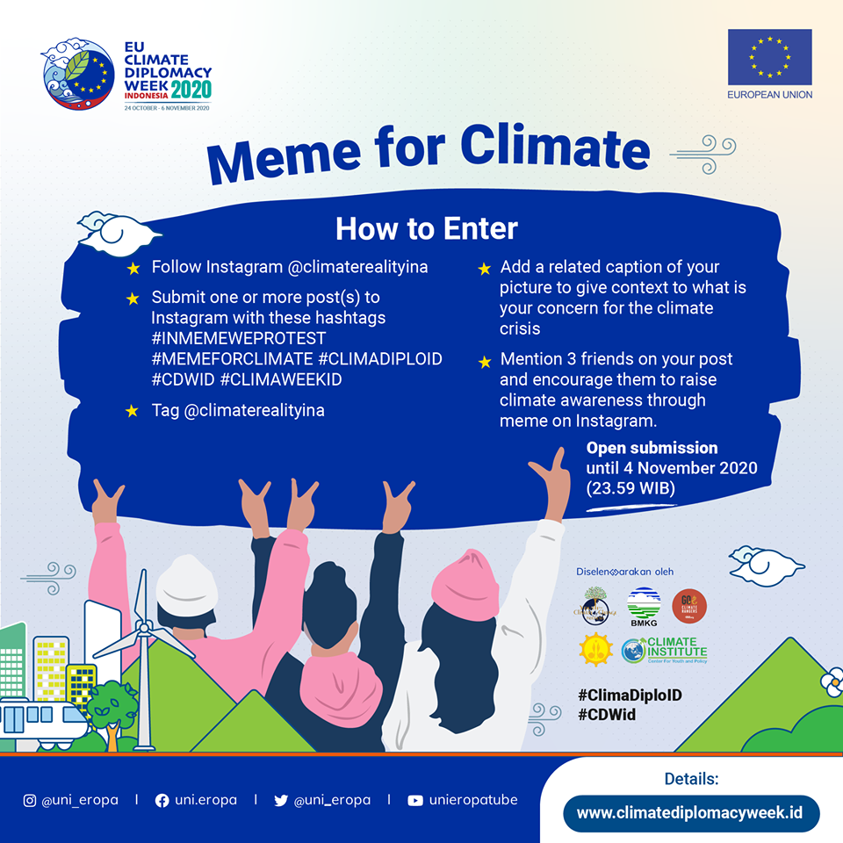
Sharing Experience from the EU CDW 2020

Slide 10
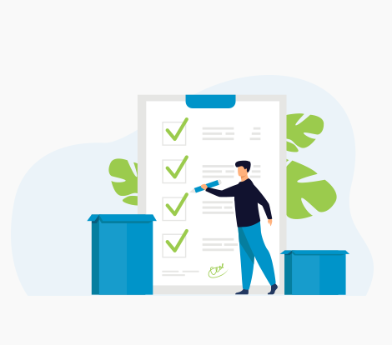
Things to prepare
Concept note/Terms of Reference
Timeline
Dedicated Team
Rundown and agenda
List of speakers
List of participants
Advance promotion (if applicable): Invitation or Open registration, microsite (landing page for registration)
Daily status documents

Slide 11
Technical Preparation (1)
Define objective of the webinar
Define target audience
Who are the VIPs
Define the outcomes of the webinar
Platform assessment
Webinar needs assessment (e.g. multilanguange interpreter, sign language interpreter, video, PPT sharing etc, livestreaming etc)

Slide 12
Technical Preparation (2)
Internet Connection assessment
Security assessment
Event sequence
Flow invitation, registration, confirmation, email reminder
Webinar etiquette for panellists, participant, and media
Announcement text (in PPT etc )

Slide 13
Ideal Personnel/Resources for the event
Technical host lead (1 person)
Technical co-host (1-2 persons) with different roles:
Liaise with the speakers
Liaise with the audience (public/invitees/beneficiaries/stakeholders/media)
Answer chat and Q&A
Mute and unmute participants
Control presentation
In charge for breakout rooms (if applicable)
Operational moderator (1-2 persons) e.g. to answer Q&A
Publication Experts, Social Media Experts,, Administrative Team, IT persons (for troubleshooting)
Additional resources e.g. Interpreter, Photo/Videographer

Slide 14
Advance Promotion
Digital promotion
Social media: Facebook, Twitter, Instagram, etc.
Group chat: WhatsApp, Line, Telegram, etc.
Paid promotion
Online media

Slide 15
So, what makes a successful Webinar?
Young people in Indonesia now say: “Kolaborasi adalah Koentji” – Collaboration is the key It is a joint effort by
Publication (and design) Team
Promotion and Social Media Team
Engagement Team
Event Team
Admin Team
IT Team
Interpreter Team
etc

Slide 16
