Slide 1
2nd Visibility Workshop for EU-funded Projects Traditional Media and Webinar Tips Tips on writing for the press
Paul Forster, LMI Team Leader
Jakarta
4 November 2020

Slide 2
Overview
Know the market

Slide 3
Overview
Know the market
Be professional

Slide 4
Overview
Know the market
Be professional
Get the timing right

Slide 5
Overview
Know the market
Be professional
Get the timing right
Spot the similarity (1, 2 & 3)

Slide 6
Overview
Know the market
Be professional
Get the timing right
Spot the similarity (1, 2 & 3)
Summary

Slide 7
Overview
Know the market
Be professional
Get the timing right
Spot the similarity (1, 2 & 3)
Summary
Questions

Slide 8
Know the media outlets
Read, research and review them.
What interests the publication?
Are there sections (e.g. News, OpEd, Features,
Sport) to aim for?
Have they covered your story already?

Slide 9
The olden days

Slide 10
Know the stylebook
Everyone wants it easy, even editors.
You want to make a long-lasting good professional impression.
You want to be successful.
At least be consistent!

Slide 11
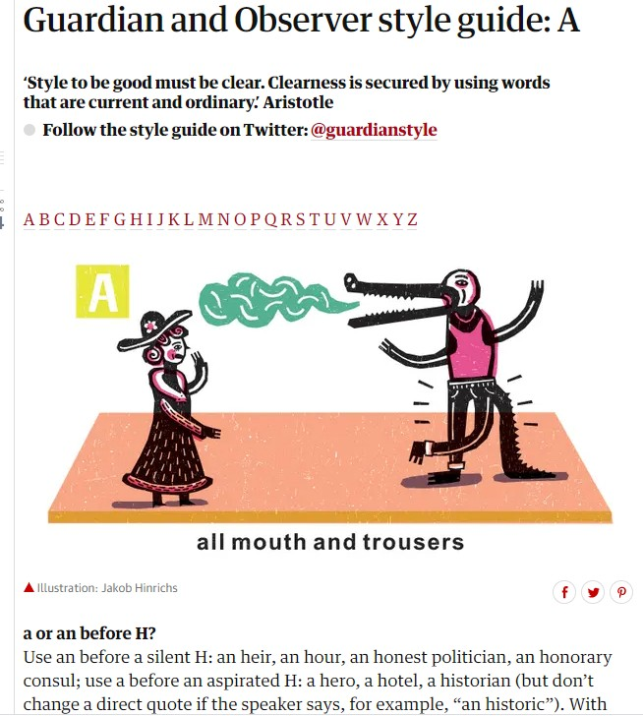
https://www.theguardian.com/guardian-observer-style-guide-a

Slide 12
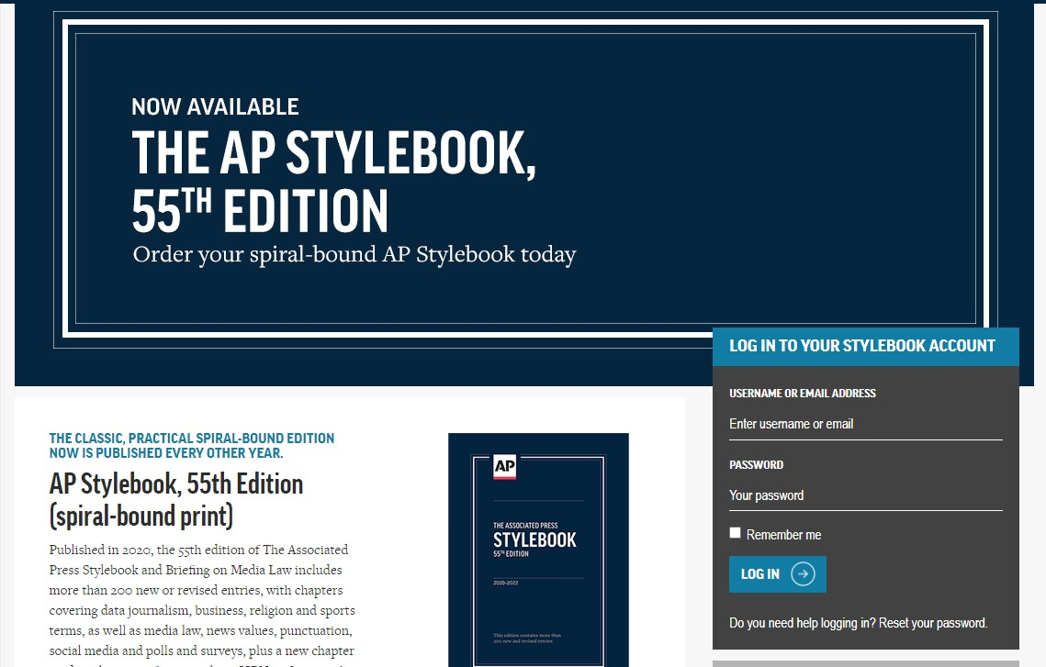
https://www.apstylebook.com/

Slide 13
https://ec.europa.eu/info/sites/info/files/styleguide_english_dgt_en.pdf

Slide 14
Why now?
Media outlet identified

Slide 15
Why now?
Media outlet identified
Style book

Slide 16
Why now?
Media outlet identified
Style book
No similar recent stories

Slide 17
Why now?
Media outlet identified
Style book
No similar recent stories
The editor’s question: WHY NOW?

Slide 18
Be timely
Stay alert – anniversaries and commemorations.
Read everything – not just the news.
Be interested in everything.
Look for the ‘hook’ for your story.
Why now? Why now? Why now?

Slide 19
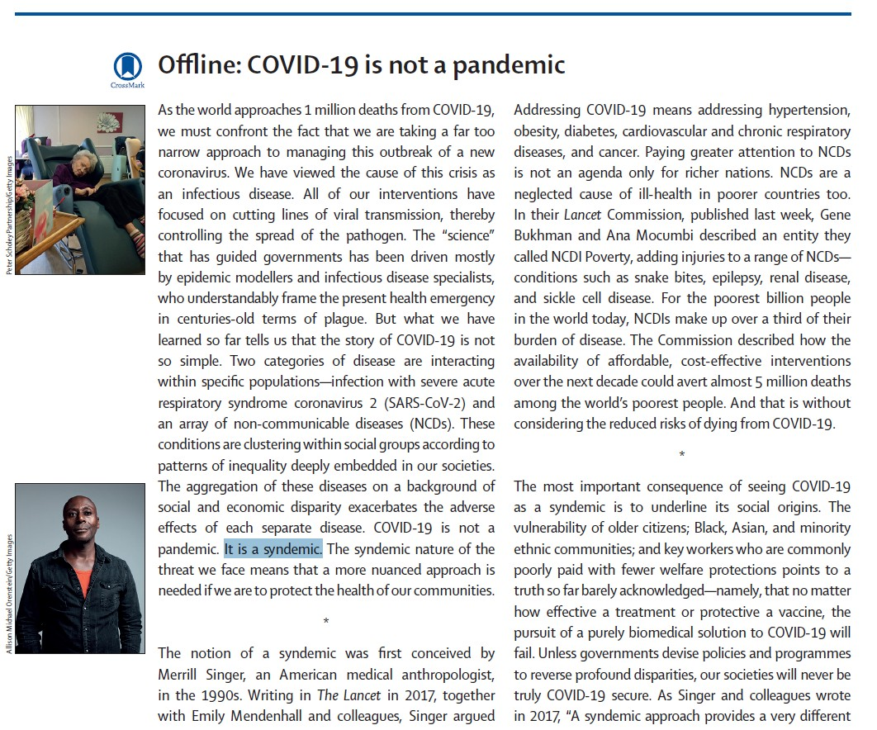
The Lancet, 26 September 2020

Slide 20
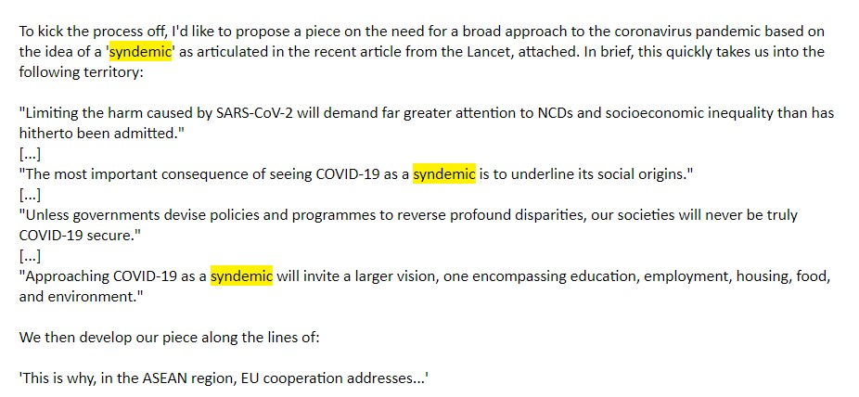

Slide 21
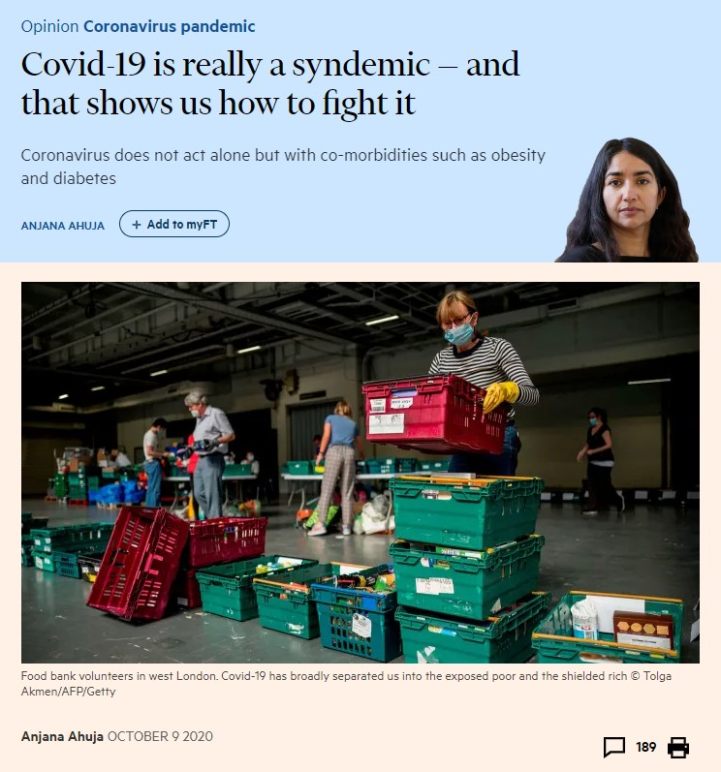

Slide 22
Procrastinate tomorrow!
News and news people move fast.
Do not sit on your hands and wait.
Believe in your story.
Believe in yourself.
If it’s a good story, someone else is on it.
[Lancet 26 Sept >>> Financial Times 9 October.]

Slide 23
Spot the similarity!
The introductions to three newspaper feature
articles follow…
What do they all have in common?
You only need read the first paragraph!

Slide 24
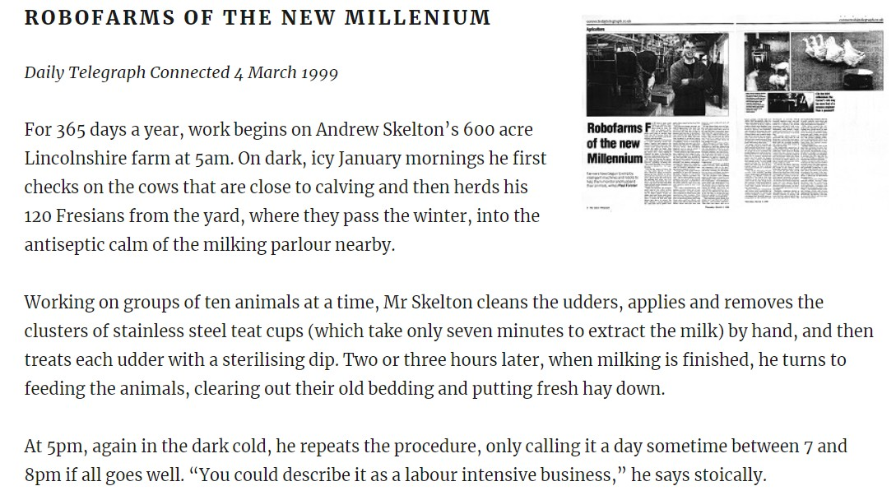

Slide 25
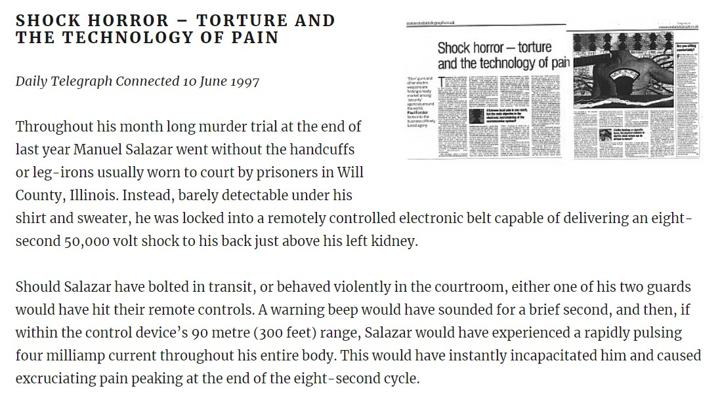

Slide 26
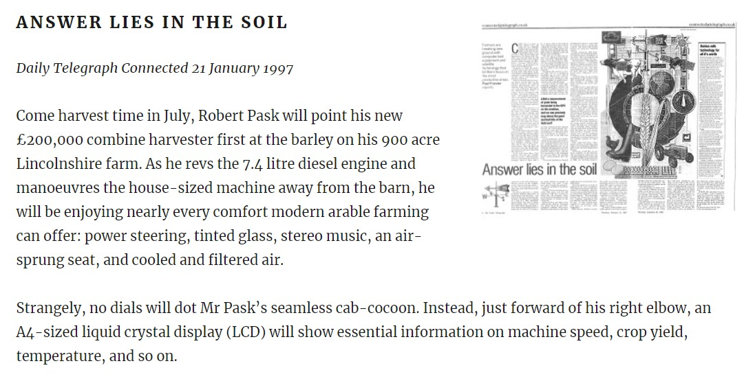

Slide 27
ANSWER:
Humans with names
People are interested in people…
People are interested in stories…
Personalise your story…
Make it real.

Slide 28
Spot the similarity!
The same three newspaper feature articles
continue…
What two things do they all have in common?
Again, it’s easy!

Slide 29
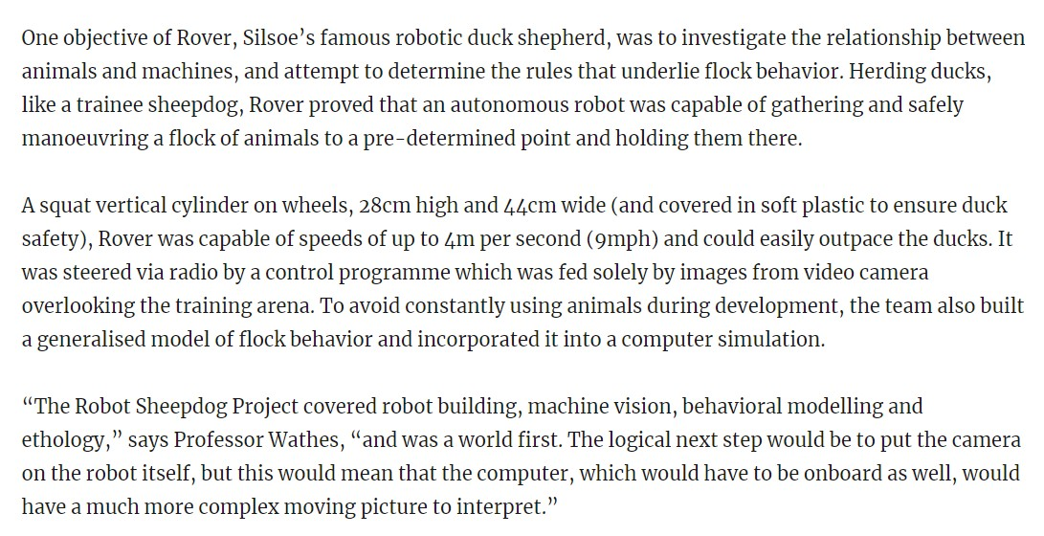

Slide 30
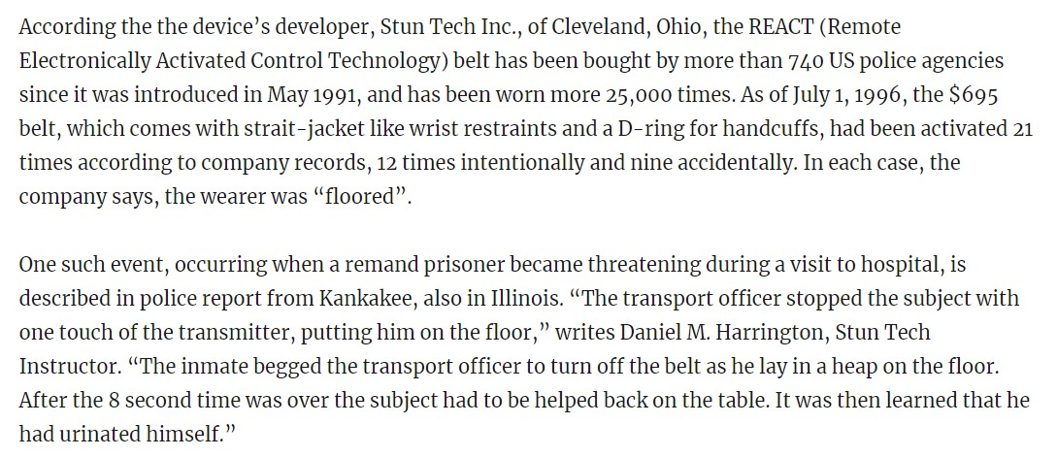

Slide 31
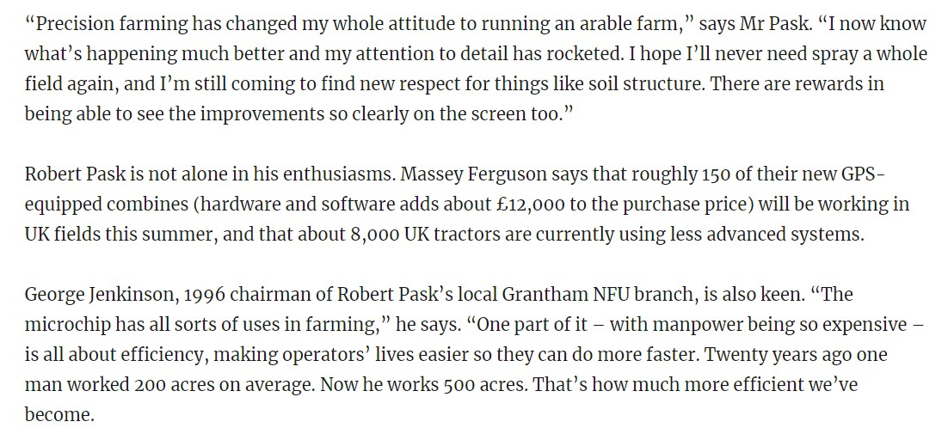

Slide 32
ANSWERS:
1 – Details make it real and add authenticity.
2 – Quotes add life and authenticity.
It’s hard work: the details and quotes must
be accurate.

Slide 33
Spot the similarity!
The same three newspaper feature articles
continue…
What do they all have in common?
This might be more difficult,
but there’s a clue!

Slide 34
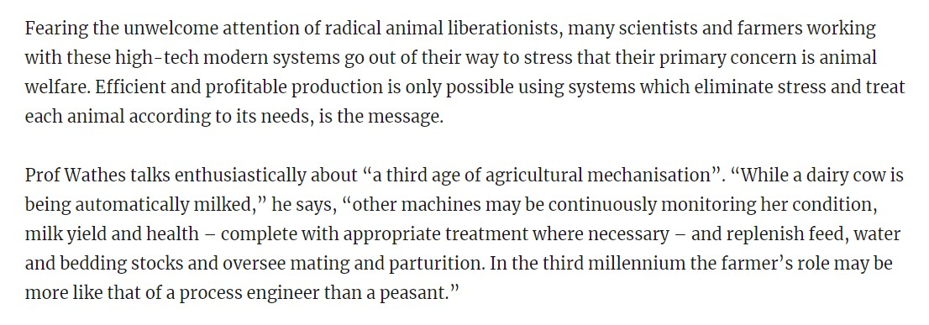

Slide 36
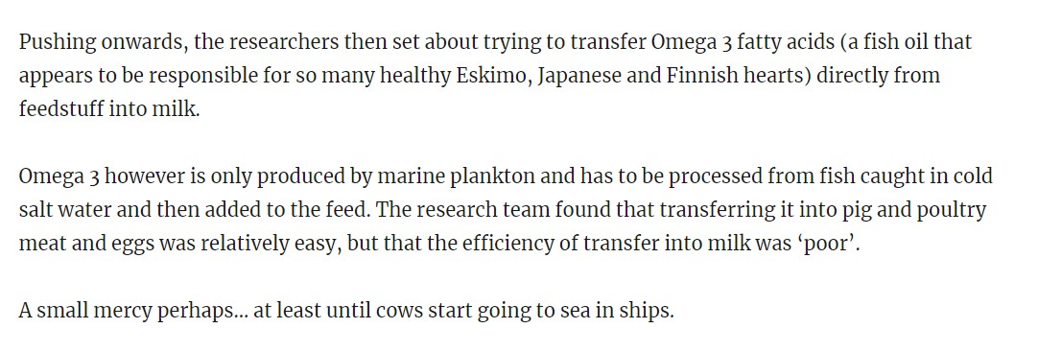

Slide 37
ANSWER:
It’s the end of the article.
Always think: beginning, middle, end.
It need not be a ‘conclusion’.
More a satisfying ‘rounding off’.

Slide 38
Summary
Know the ‘marketplace’.

Slide 39
Summary
Know the ‘marketplace’.
Be professional, be detailed, be accurate.

Slide 40
Summary
Know the ‘marketplace’.
Be professional, be detailed, be accurate.
Build long-term relationships.

Slide 41
Summary
Know the ‘marketplace’.
Be professional, be detailed, be accurate.
Build long-term relationships.
Why now? Why now? Why now?

Slide 42
Summary
Know the ‘marketplace’.
Be professional, be detailed, be accurate.
Build long-term relationships.
Why now? Why now? Why now?
Think: beginning – middle – end.

Slide 43
Summary
Know the ‘marketplace’.
Be professional, be detailed, be accurate.
Build long-term relationships.
Why now? Why now? Why now?
Think: beginning – middle – end.
Tell moving human stories.

Slide 44
Questions
THANK YOU VERY MUCH
“The great enemy of clear language is insincerity.”
George Orwell, Politics and the English Language (1946)
www.paulforster.com

